Slide 1
12- Quiz

Slide 2
context
Q1 3
A1 4
Q2 5
A2 6
Q3 7
A3 8

Slide 3
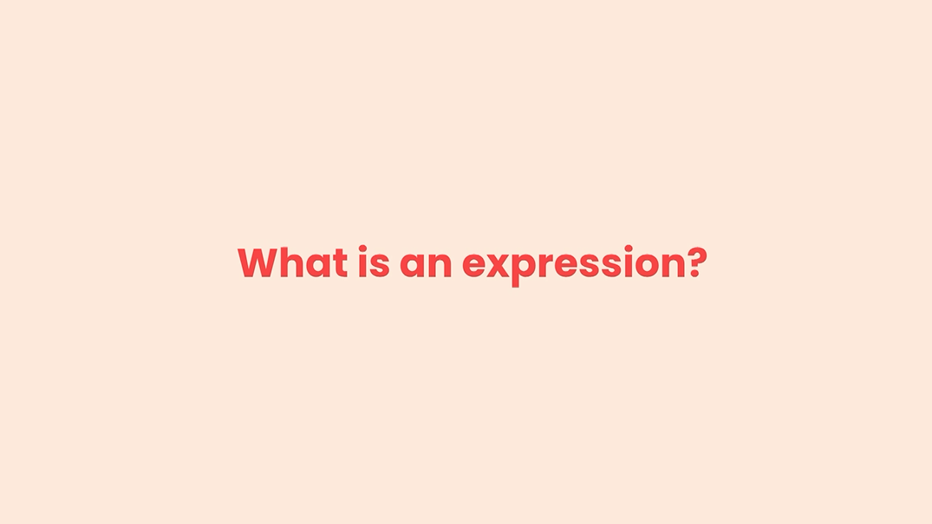
Q1

Slide 4

A1: What is an expression?
An expression is a piece of code that produces a value.
Here's an example of an expression:
What do you think is the value of this expression?
Well here we have this string We're multiplying this by 3.
So the result will be a string of three asterisks like this

Slide 5
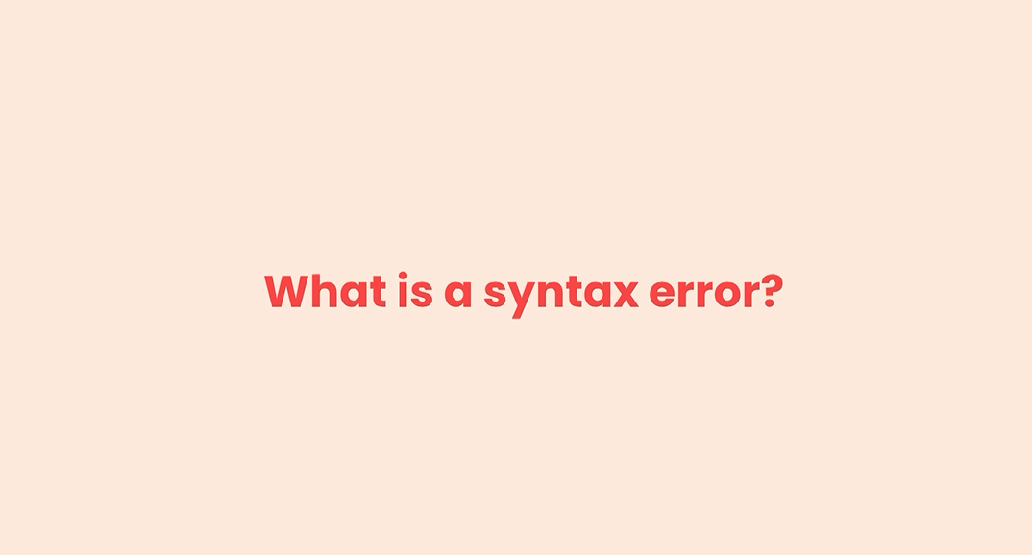
Q2

Slide 6
A2: What is a syntax error
A syntax error is a kind of error that is due to bad syntax or bad grammar in the code.

Slide 7
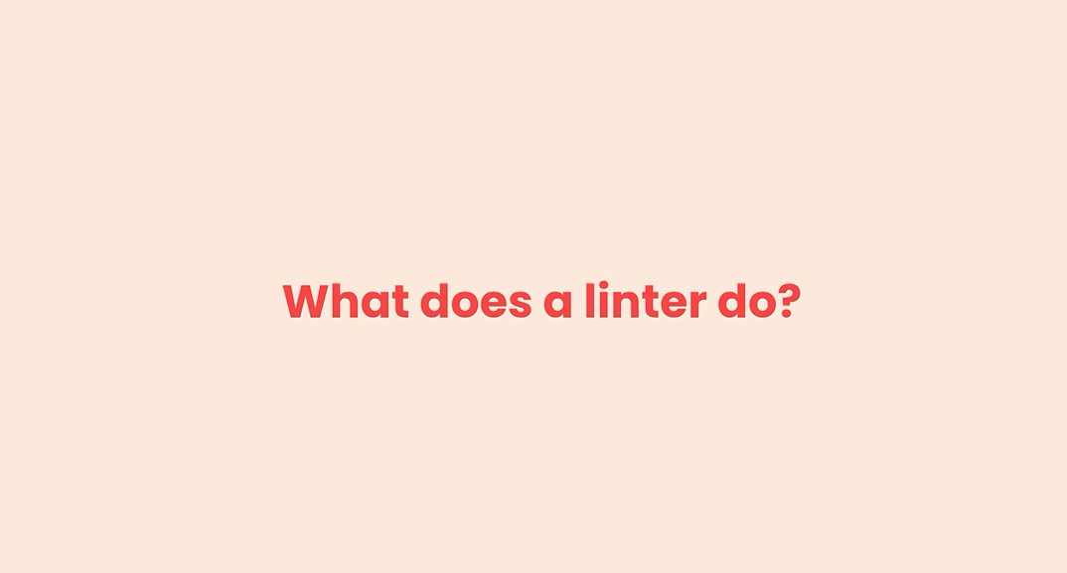
Q3

Slide 8
A3: What does a linter do?
A linter is a tool that checks our code for potential errors mostly in the category of syntactical Errors.
So if you have grammatical issues in our code, the linter will tell us before running a program.

